Slide 1
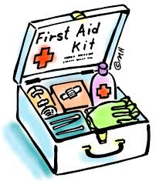
Kitchen Safety
Developed by Ms. Tiffany Newman, 2014

Slide 2
Objectives
Demonstrate proper methods of kitchen safety/first aid.
Identify kitchen safety procedures.
Utilize kitchen utensils/equipment properly.
Execute proper knife handling skills and cuts.

Slide 3
General Safety
Don’t let hair, jewelry, sleeves, or apron strings dangle.
Stay focused!
Close all drawers and cupboards as you go.
Use the right tool for the job.
Clean up as you go!

Slide 4
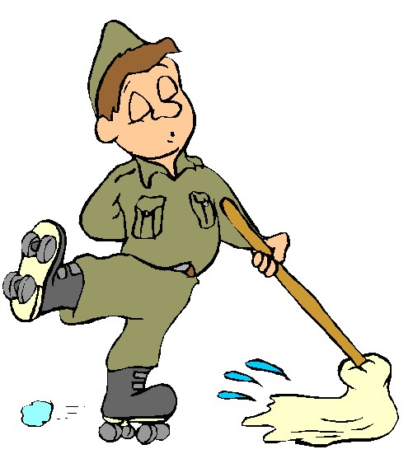
Preventing Falls
Keep floor clean and clear of clutter.
Wipe up any spills.
Shoelaces should be tired.
Warn everyone when something is spilled!

Slide 5
Cuts
Keep knives sharp and use them properly.
Always store knives in their connect home.
Do not try to catch a falling knife!
Do not soak knives in the sink.
Keep knives on the edge of the sink after being used.
Sweep up any broken glass immediately.

Slide 6
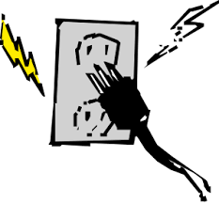
Electricity Safety
Keep all electrical elements away from the water.
Watch for damaged cords.
Cracked, loose or frayed wires.
Use outlets properly.
Be sure not to plug in too many appliances to one outlet
Be aware for any problems that you think may be happening with your appliance.

Slide 7
Chemicals
These can include:
Oven cleaners, lighter fluid, drain cleaners, and pesticides.
Always read the labels on chemical containers.
Never mix different chemical products.
When using a spray nozzle, point nozzle directly where you want it to spray.

Slide 8
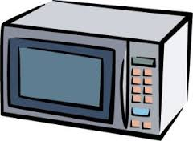
Range & Microwave Accidents
Always use oven mitts when picking up or uncovering pans.
Always lift the pan lid away from yourself.
Always keep pan handles turned toward the back or middle of the stove top.
Keep all flammable items away from the burners.

Slide 9
Oven Safety
Always arrange oven racks properly before you start the oven.
Stand to the side when opening the oven door.
Do not reach into a hot oven!
Pull out the rack with the pan on it to remove from the oven.
Clean up all spills and crumbs when oven is cooled down.
Always be sure to have all switches turned off.

Slide 10
If a fire starts…
On the range:
Turn off the heat.
Cover the pan, or pour salt or baking soda on the flame.
Never use water- if a grease fire, the grease will splatter, causing the fire to possibly spread.
Oven, broiler, microwave, or toaster oven:
Turn off or disconnect the appliance.
Keep oven door closed until the fire goes out.
Never carry a pan with burning contents!

Slide 11
In case of an Accident…
Cuts/Bleeding
Burns
1st, 2nd, 3rd degree
Chemical
Fractures
Poisoning
Choking
Heimlich maneuver
CPR

